Slide 1
GAGGAR ENTERPRISES PVT. LTD.
IT’S JOURNEY OVER THE LAST 25 YEARS

Slide 2

Gaggar Enterprises Pvt. Ltd. (Ahmedabad Division)
Gaggar Enterprises have been in the industry for for FMCG & packaging products for almost 2 & a half decades
The Ahmedabad plant has 2 main divisions, Preform Manufacturing and Water Production integrated with Packaging.
It is a Fully Automated plant having an End-To-End Process completely In-house right from the stage of Preform manufacturing, blowing bottles, filling & packaging all done under one single roof to ensure quality in the product.

Slide 3
Divisions Of Gaggar Ent. Pvt. Ltd.
AHMEDABAD MOTHER PLANT
(WATER AND PREFROM DIVISION)
JAIPUR WATER
MANUFACTURING PLANT (FOR GALLONS)
OMAN WATER MANUFACTURING PLANT DISTRBUTION CENTRE FOR PREFORM
DAMAN PREFROM MANUFACTURING PLANT

Slide 4
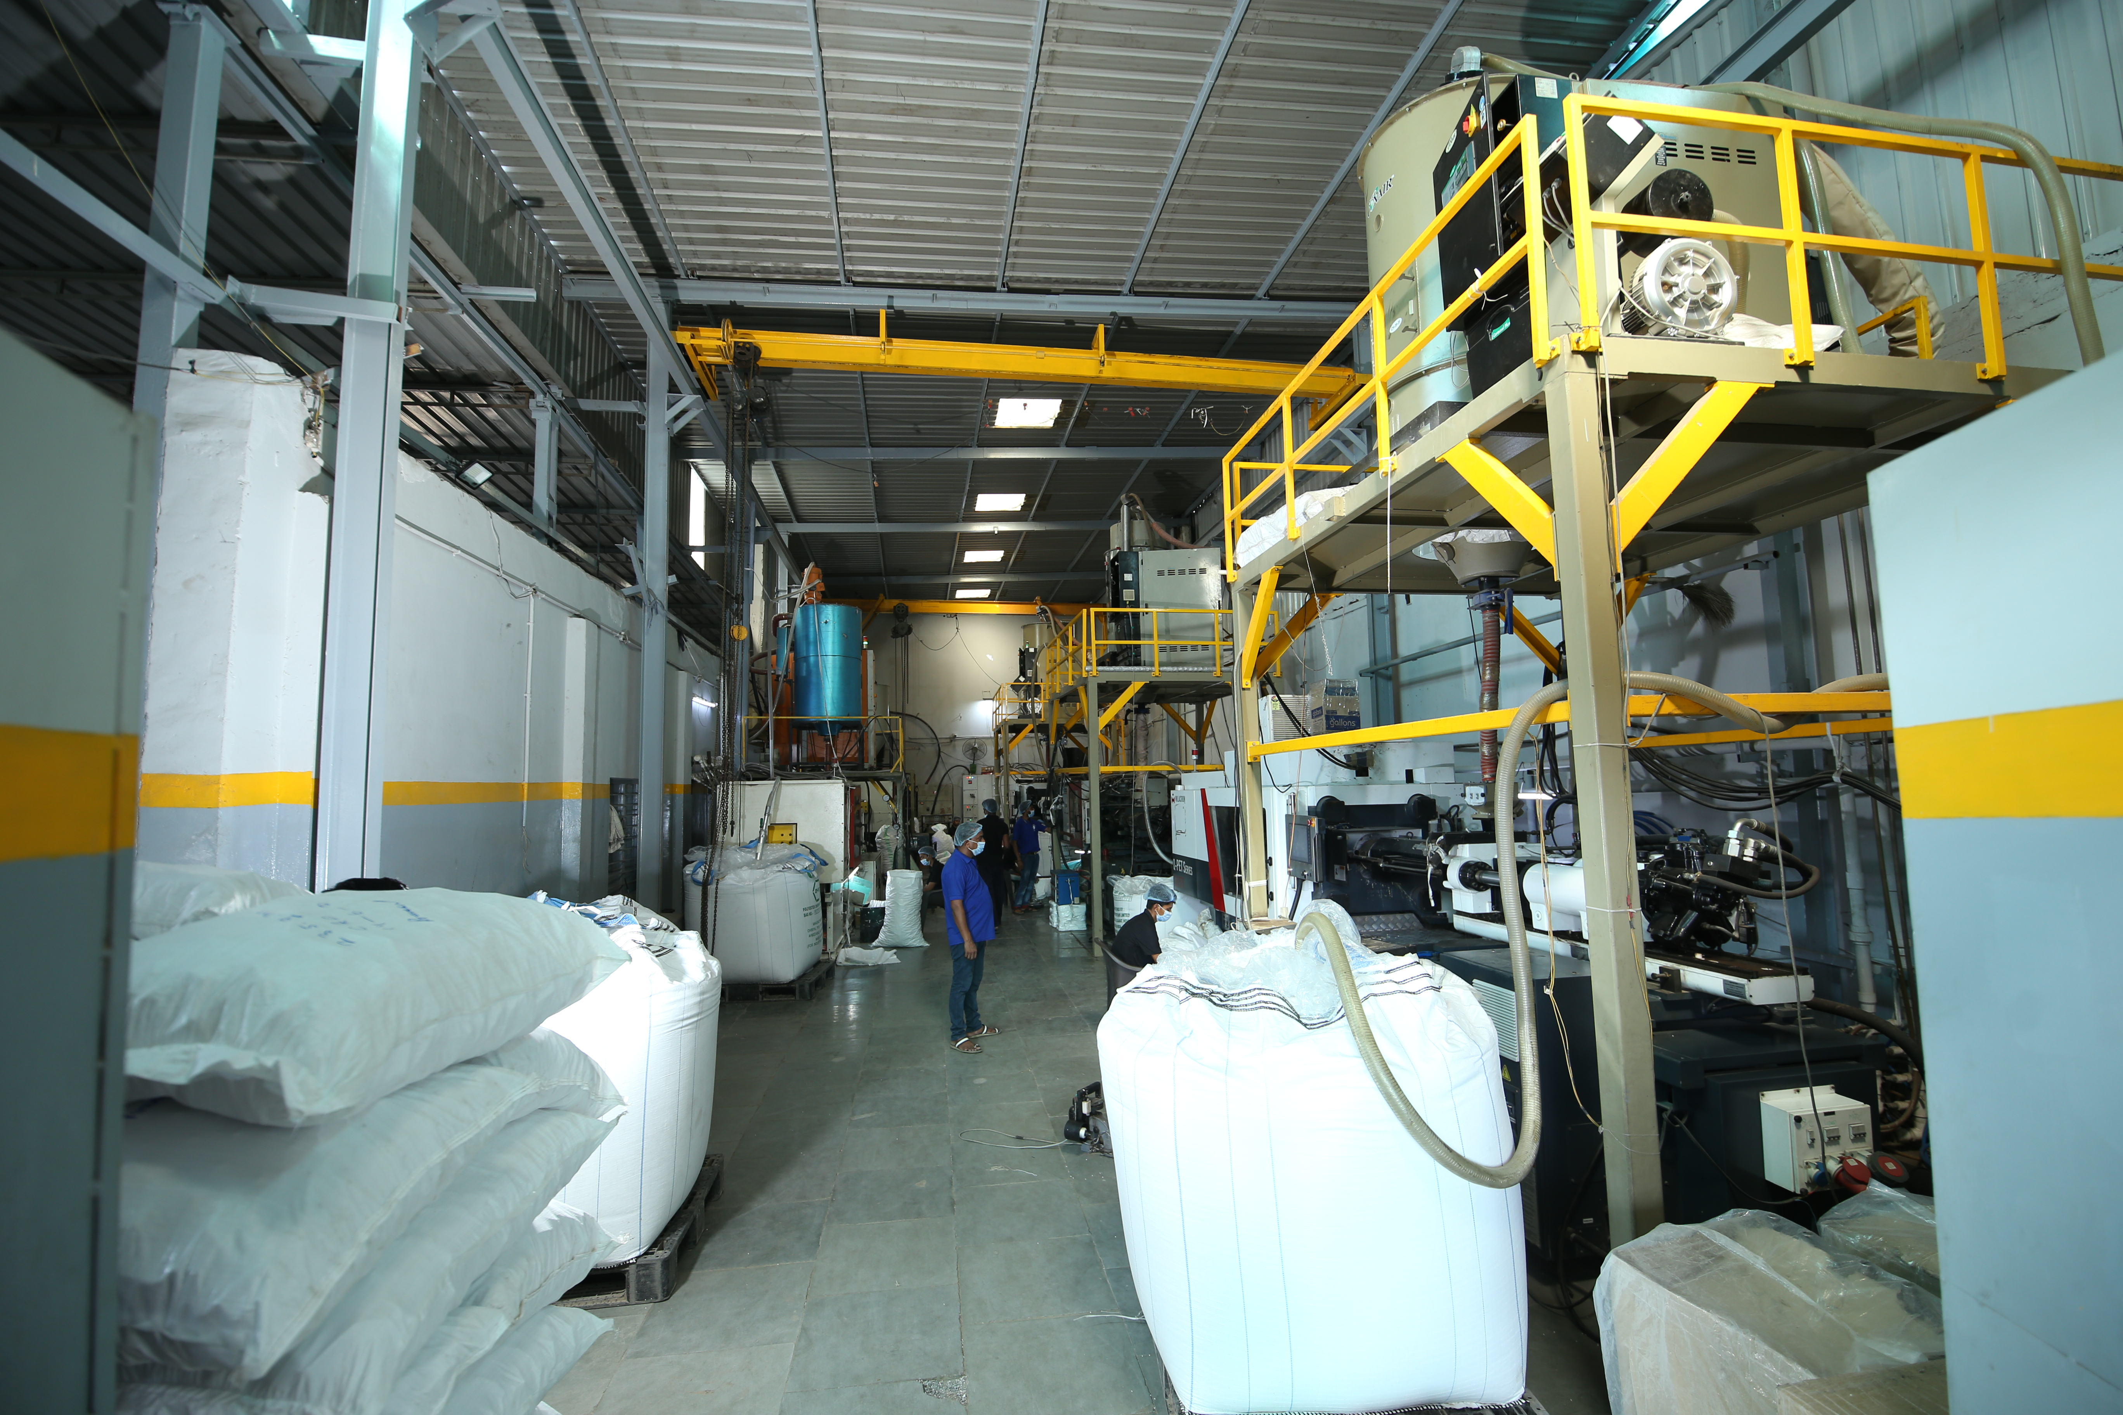
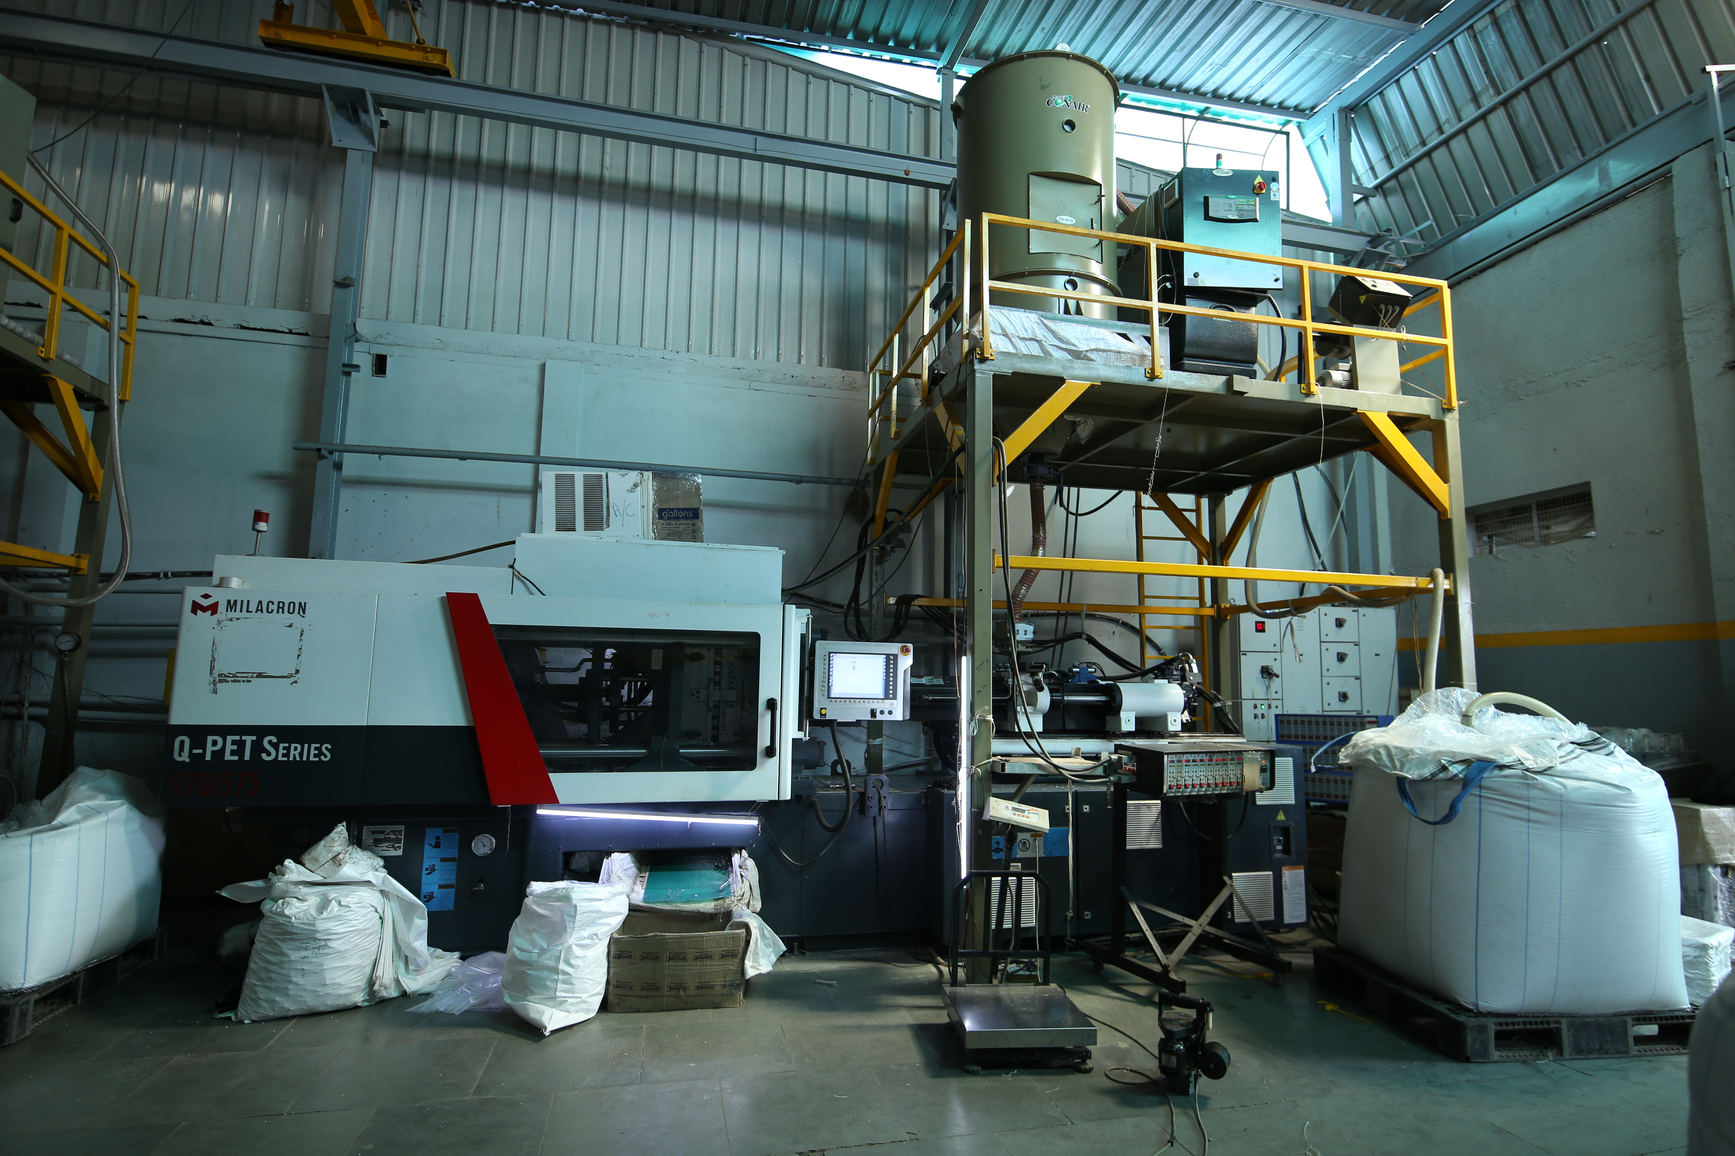
Gaggar Enterprises Pvt. Ltd.(PET Preform Division)
We have been in the business of manufacturing PET Preforms since past 10 years with manufacturing facility Ahmedabad, Gujarat and having depots in Mumbai, Udaipur and Jaipur for distribution of PET Preforms in India.
For the past 2 years, we have started exporting 29/25 PET Preforms in Oman, having our depot at Sohar.
We are currently offering PET Preforms to bottled water and oil industries in India and overseas.
We have 2 Milacron 180s and 3 Milacron 150s (USA) PET Series industrialized machines which has been supplying customized systems in the plastic generation and processing industry since 1860.
We have the potential to manufacture 300 Tons of PET Preforms at present across a variety of industries and applications, and we are within the manner of doubling our PET- Preform manufacturing ability to 800 Tons monthly by the year 2023.

Slide 5
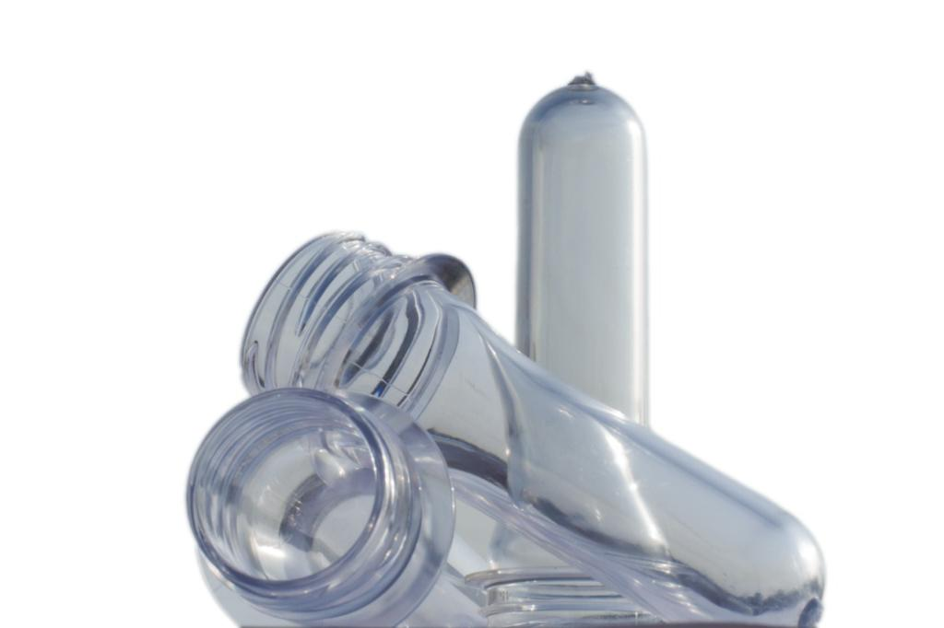
Our Product Range
ALASKA
NECK: 28 MM
GMS
8.4
9.6
12.4
13.6
18.5
19.1
20.6
ALASKA SHORT NECK
NECK: 26 MM
GMS
6.6
9.8
CTC (EDIBLE OIL)
NECK: 29 MM
GMS
14.8
23.5
26
EXPORT
NECK: 29/25
GMS
7.8
8.2
11.8
FRIDGE BOTTLE
NECK: 36 MM
53 GMS
RED
BLUE
GREEN

Slide 6
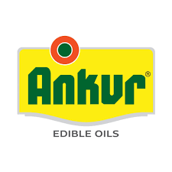
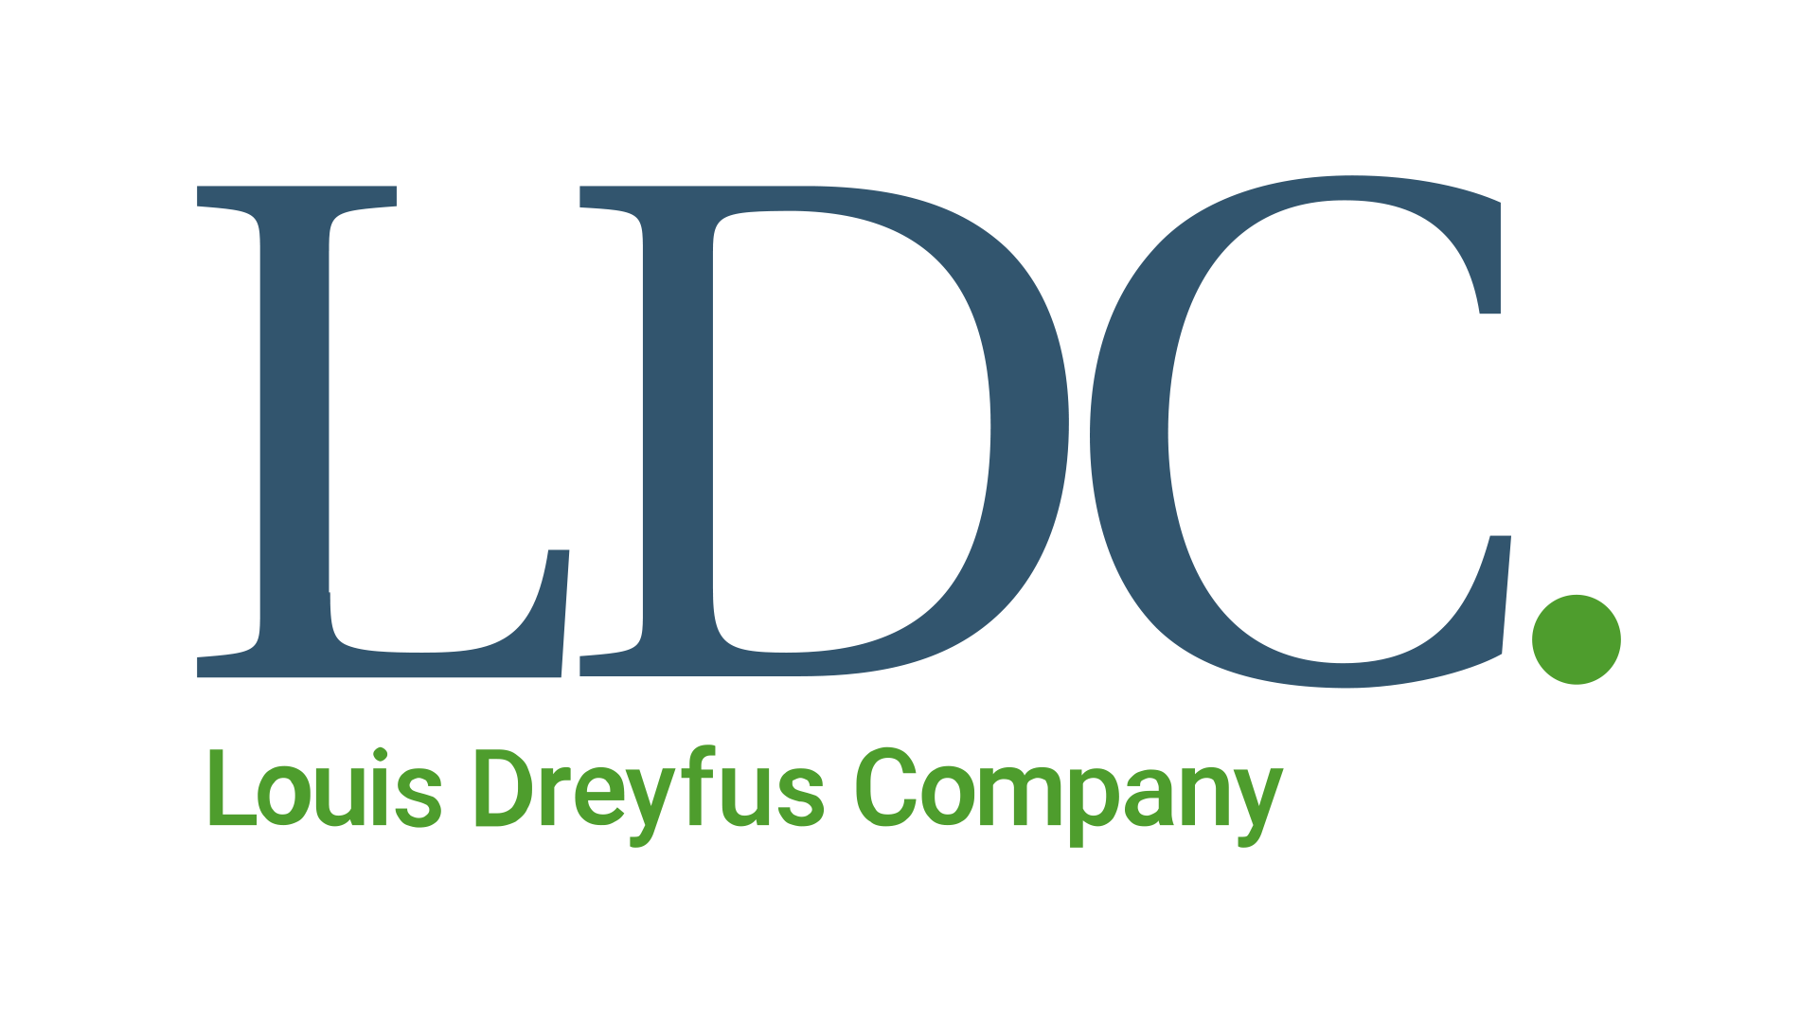
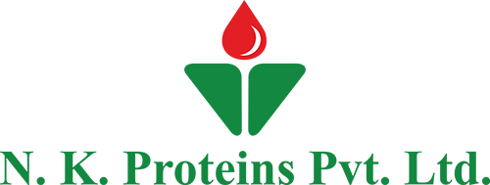

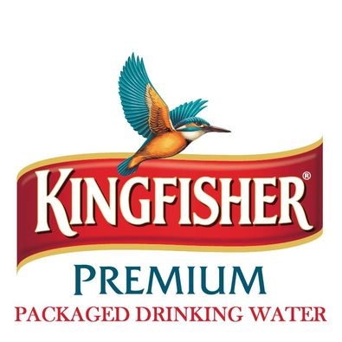
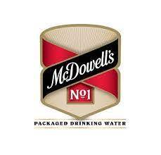

Some of our Preform Clientele

Slide 7
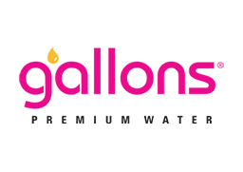
About Gallons
Over the years, we have not only managed to increase our presence into many parts of the country, but have also created a strong visibility for the brand across various sectors. Gallons has made its way into niche markets like hotels, clubs and catering along with mass consumption markets like railways and airlines with its presence being in more than 8 states. BIS certified Plant covered under both Central and Regional FSSAI, an ISO 22000:2005, the latest certification in Food safety standard with a fully equipped lab as per BIS standards for Chemical as well as Micro testing. We have a full-time Micro and Chemist on board our production team to ensure that each batch is tested every 4 hours.

Slide 8






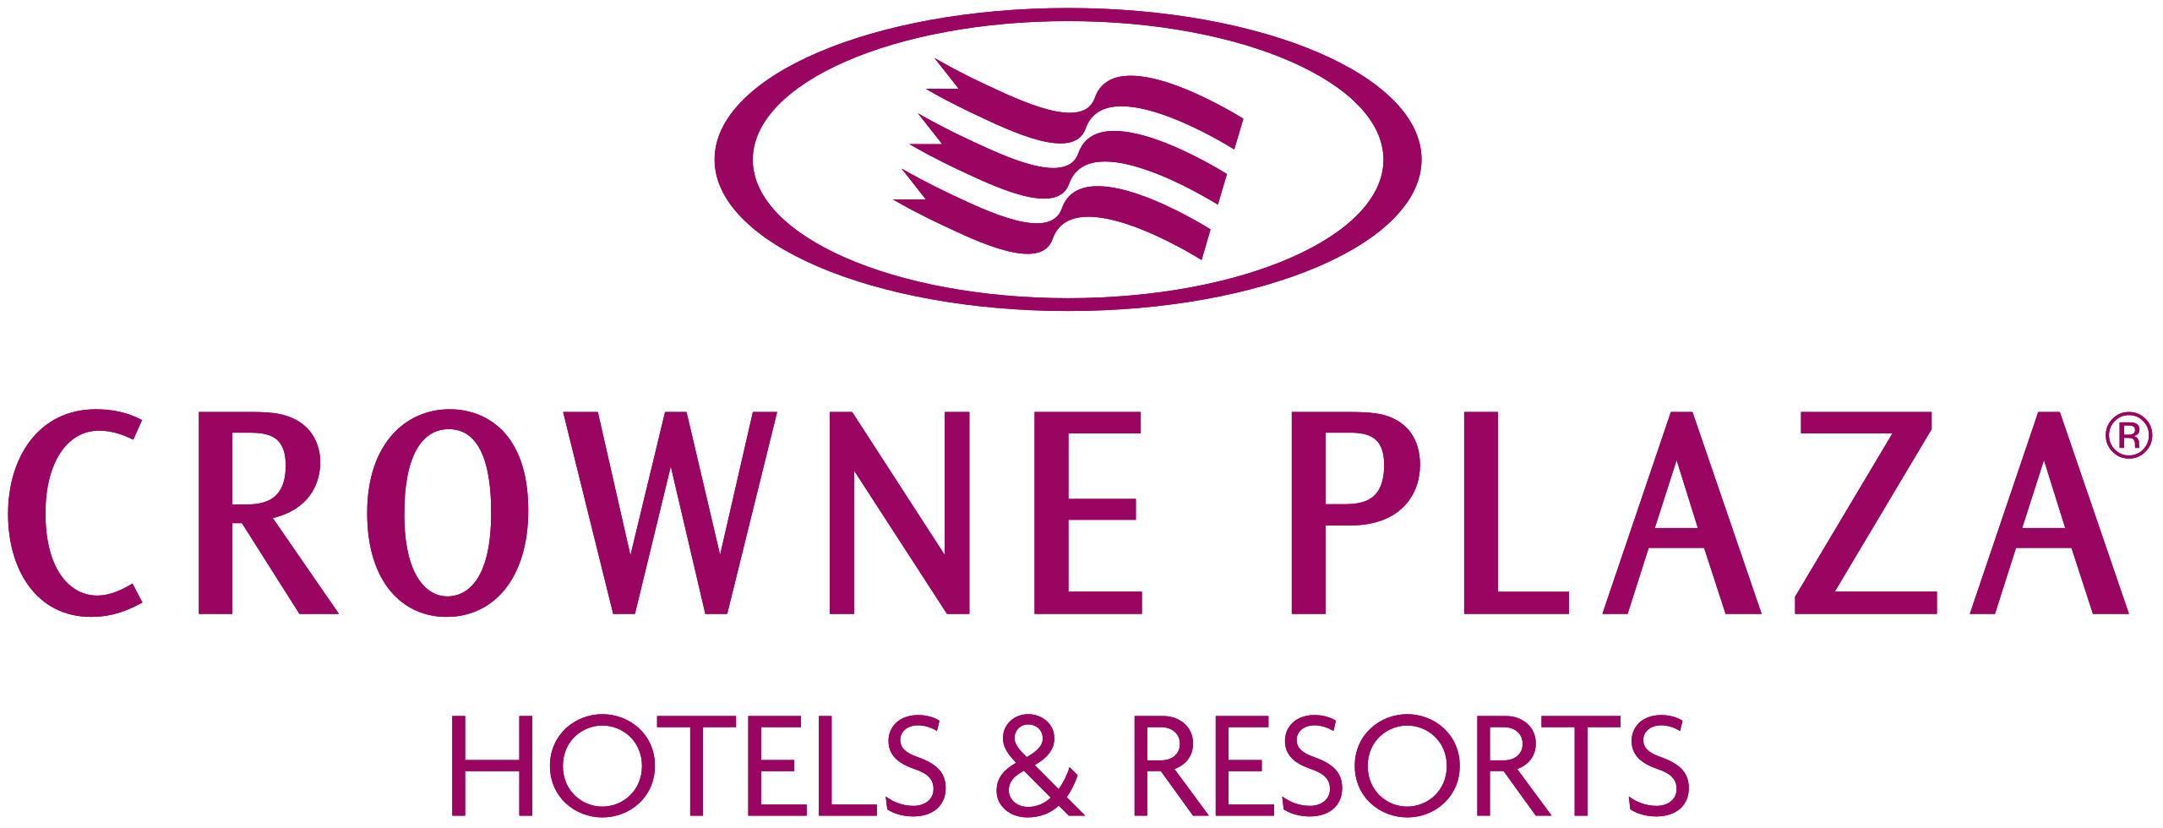


Our Premium Indian Clientele

Slide 9

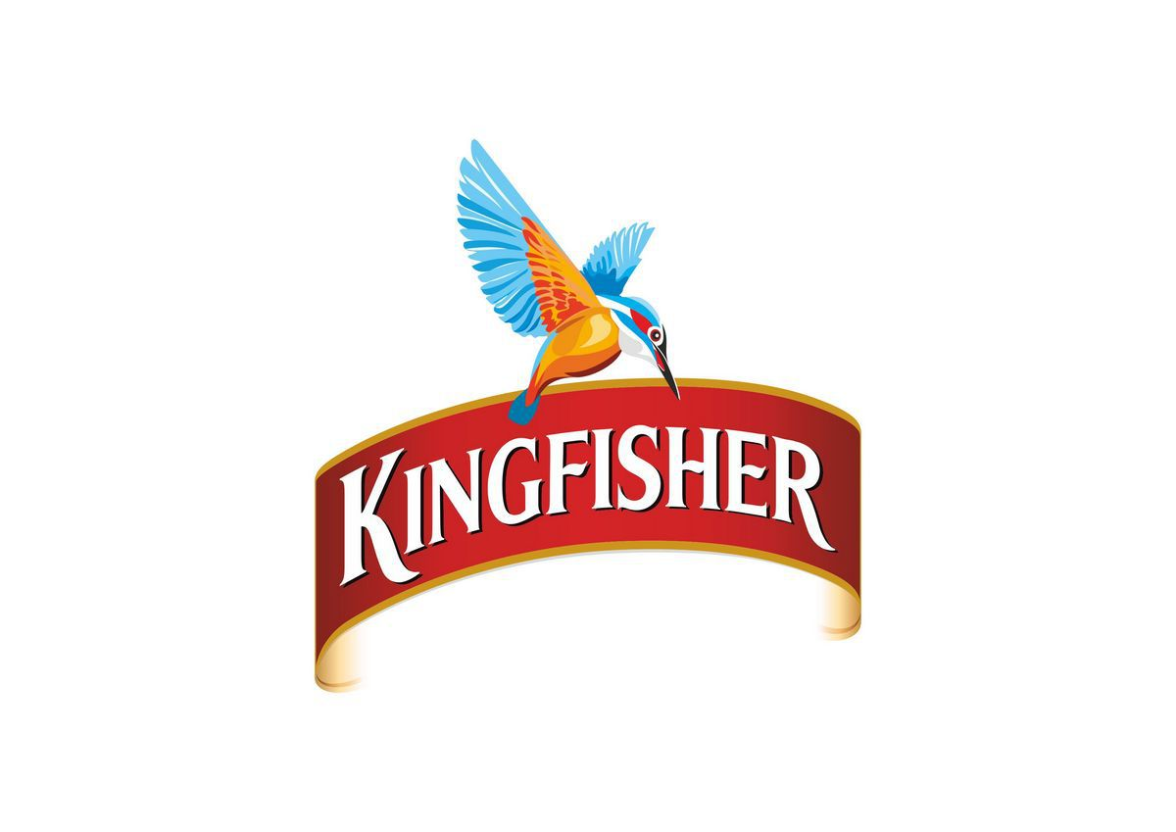

Premium Co-Packing Tie Ups For Water

Slide 10
Our Oman Business
Owned and operated by GAGGAR ENT. PVT. LTD. We have been in Oman for a almost 4 years and we have established our own brand named Suhool. The brand is operated by Starbright LLC. It has been catering to people’s need for almost the same amount of time. Suhool is Low sodium packaged drinking water being made in 33,000 square feet of factory land in Sohar in the Sultanate of Oman, catering to upscale supermarkets.

Slide 11
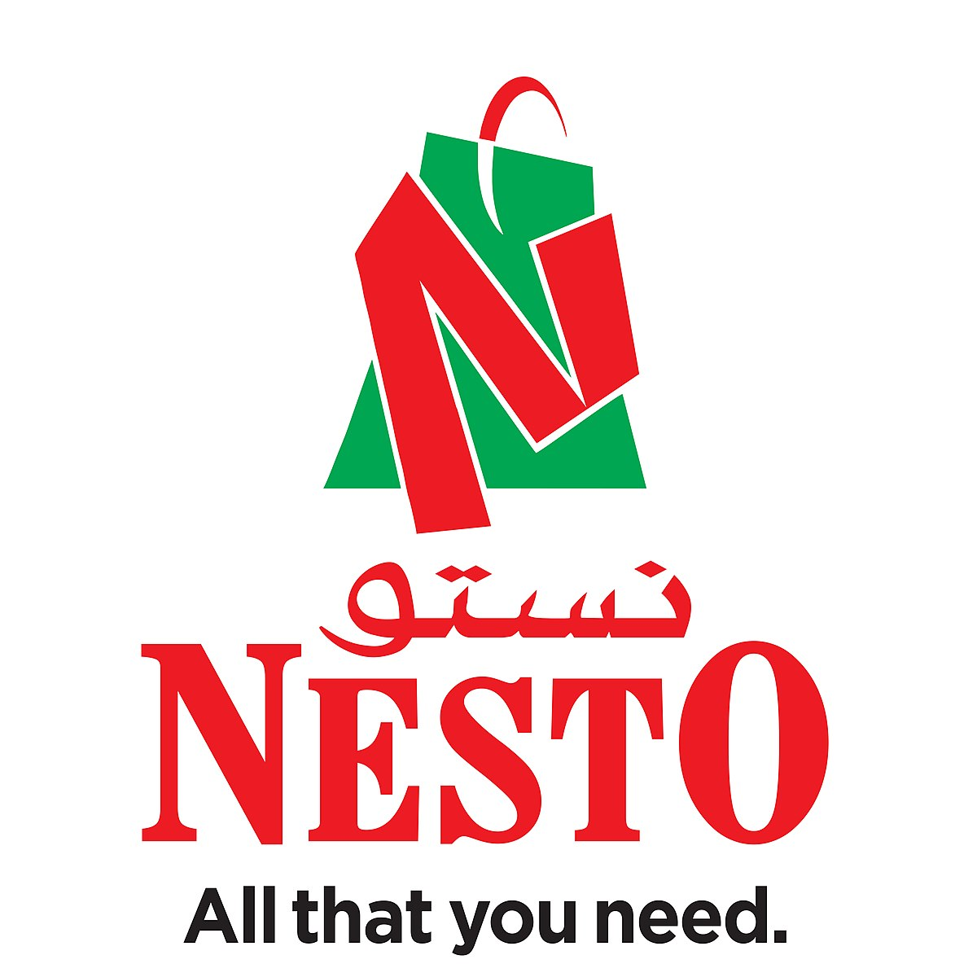




Some Of Our Omani Clientele

Slide 12
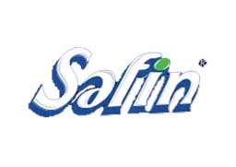
Some of our other brands
The next big packaged drinking water brand in the making located in Jaipur.
Perfectly balanced pH packaged drinking water that has a crisp and refreshing taste every time you fill your glass also being made in Sultanate of Oman.

Slide 13
Landmark Events
Induction of new partners - 2020
Increase and influx of new equity - 2020
Acquisition of Oman plant - 2021
Acquisition & start-up of Amicale Imperia (Jaipur plant) - 2021
Acquisition of Mulshi, Natural Mineral Water Brand - 2021
Preform capacity addition by 120 tonnes - 2022
Addition of leased preform plant Daman & capacity increased by 80 tonnes - 2023

Slide 15
THANK YOU

